Slide 1
European Defense Tech Hackathon – Munich 2025
Localising radars to protect freedom in the skies (Helsing Challenge)
Lukas, Moritz, Nic, Hector

Slide 2
The problem:
Enemy radars disrupt operations by providing early warnings of sorties by air and ground support, but are difficult to locate
Notes:
Add newspaper clippings

Slide 3
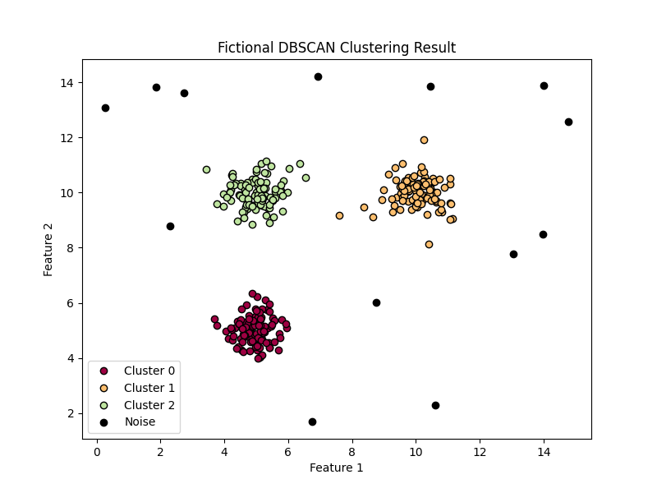
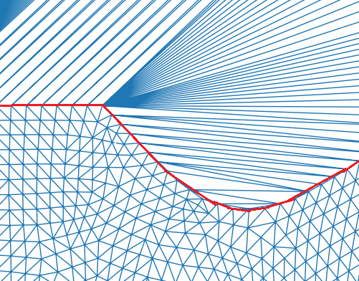
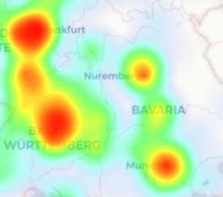
The solution*:
Use radars’ own emissions to locate them
Cluster-based approximation of enemy radars
Triangulation of specific radar locations
Visualization of areas of likely radar locations to target interventions
*: developed from scratch in Python.
Notes:
Add a diagram of the workflow

